Slide 1
Supervised Learning​
PE29 Vasu Kalariya​
PE30 Sakshi Patil​
PE 14 Payal Patil​
PE 16 Vaishanvi​ Salunke

Slide 2
Machine Learning
“Learning is any process by which a system improves performance from experience.” - Herbert Simon​
by Tom Mitchell​
Machine Learning is the study of algorithms that
improve their performance P
at some task T
with experience E.

Slide 3
Traditional Programming
Machine Learning
input
Computer System
Output
Program
Program
Data
Computer System
Program(model)
Output

Slide 4
Types of Learning
Supervised (inductive) learning
Given: training data + desired outputs (labels)
Unsupervised learning
Given: training data (without desired outputs)
Semi-supervised learning
Given: training data + a few desired outputs

Slide 5
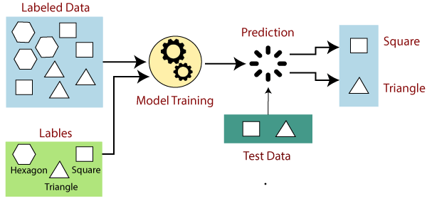
How Supervised Learning Works?
.

Slide 6
Steps Involved in Supervised Learning:
First Determine the type of training dataset
Collect/Gather the labelled training data.
Split the training dataset into training dataset, test dataset, and validation dataset.
Determine the input features of the training dataset, which should have enough knowledge so that the model can accurately predict the output.
Determine the suitable algorithm for the model
Execute the algorithm on the training dataset.
Evaluate the accuracy of the model by providing the test set. If the model predicts the correct output, which means our model is accurate.

Slide 7
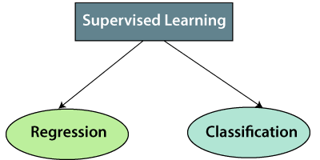
Types of supervised Machine learning Algorithms:
.

Slide 9
Advantages of Supervised learning:
With the help of supervised learning, the model can predict the output on the basis of prior experiences.
In supervised learning, we can have an exact idea about the classes of objects.
Supervised learning model helps us to solve various real-world problems such as fraud detection, spam filtering, etc.

Slide 10
Disadvantages of supervised learning:
Supervised learning models are not suitable for handling the complex tasks.
Supervised learning cannot predict the correct output if the test data is different from the training dataset.
Training required lots of computation times.
In supervised learning, we need enough knowledge about the classes of object.

